Slide 1


Pedro Salvado
17th Octobre 2022

Slide 2

Outline
Executive Summary
Introduction
Methodology
Results
Conclusion
Appendix

Slide 3
Executive Summary
Summary of methodologies
Data Collection through API
Web Scraping for data collection
Data Wrangling
Exploratory Data Analysis (EDA):
With SQL
Data Visualization
Visual Analysis with Folium
Visual Analysis with Dash Plotly
Machine Learning:
Classification
Cross Validation
Summary of all results
EDA results
Predictive Classification and comparison between algorithms

Slide 4
Introduction
Project background and context
SpaceX advertises Falcon 9 rocket launches on its website with a cost of 62 million dollars; other providers cost upward of 165 million dollars each, much of the savings is because SpaceX can reuse the first stage. Therefore if we can determine if the first stage will land, we can determine the cost of a launch. This information can be used if an alternate company wants to bid against SpaceX for a rocket launch. The goal of the project is to predict if the first stage will land successfully.
Problems you want to find answers
What factors influence the landing success of the first stage;
If there are any set of conditions that influence the landing of the first stage

Slide 5

Section 1

Slide 6
Methodology
Executive Summary
Data collection methodology:
Data was collected through SPACEX API and web scraping from Wikipedia
Perform data wrangling
Correct missing data and OneHot Encoding and StandardScaler
Perform exploratory data analysis (EDA) using visualization and SQL
Perform interactive visual analytics using Folium and Plotly Dash
Perform predictive analysis using classification models
How to build, tune, evaluate classification models

Slide 7
Data Collection
Methodologies:
Data collection was done using the get request method to the SPACEX API.
Then decoded the response through json() function and then created a Pandas dataframe through json_normalize() method;
After a first glance at the data there was a need to correct some missing data, ‘Payloadmass’, using the mean of overall values and fill the missing values with that value.
Web Scraping to get the Falcon9 records.

Slide 8
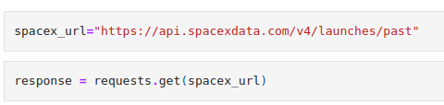
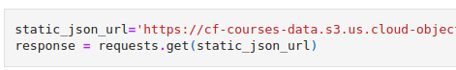
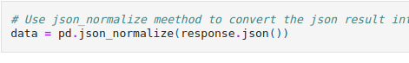
Data Collection – SpaceX API
Get request method to the API.
Create Dataframe
Link: https://github.com/pmgsalvado/Coursera---SpaceX-/blob/main/jupyter-labs-spacex-data-collection-api.ipynb

Slide 9
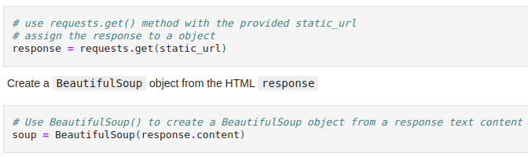
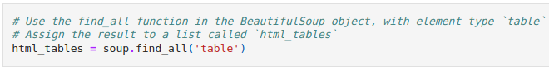
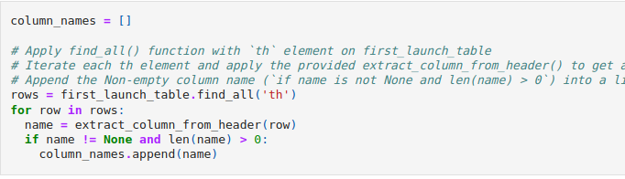
Data Collection - Scraping
Web scrap to wikipedia to get the Falcon 9 launch records. BeautifulSoup helped with identifying table – table headers and table cells
Link: https://github.com/pmgsalvado/Coursera---SpaceX-/blob/main/jupyter-labs-webscraping.ipynb

Slide 10
Data Wrangling
The first step was to perform Exploratory Data Analysis (EDA) to correct missing values and identify the attributes.
We identified the number of launches by site, what were the orbits and the number of launches by orbit.
We then created a new column, Class, with success and unsuccess landing.
Link: https://github.com/pmgsalvado/Coursera---SpaceX-/blob/main/Data%20Wrangling%20EDA.ipynb

Slide 11
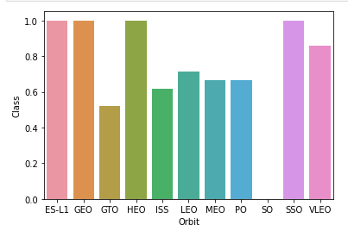
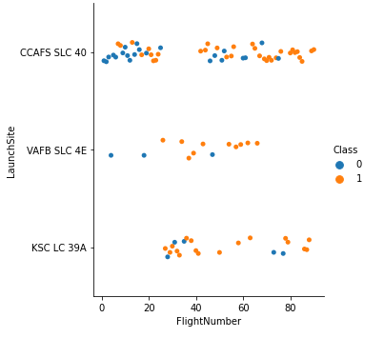
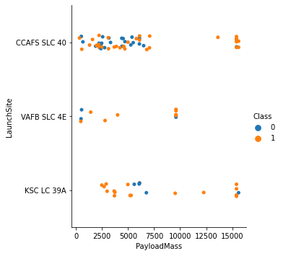
EDA with Data Visualization
We visualized the relationship between FlightNumber and LaunchSite, between the Payload and LaunchSite, SuccessRate and Orbit and PayLoad and OrbitType. (each with distinction Success/ unsucess)

Slide 12
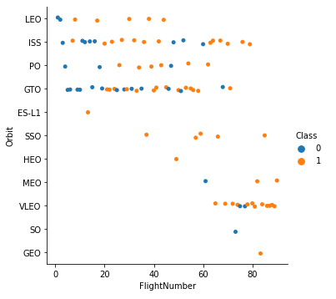
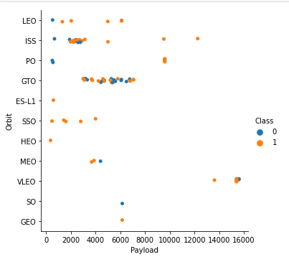
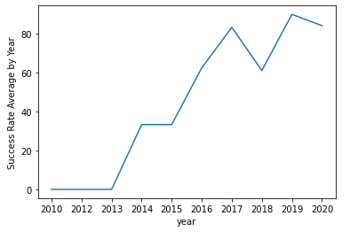
EDA with Data Visualization
We visualized the relationship between FlightNumber and Otbit, between the Payload and Orbit and the evolution of the success over the years.

Slide 13
EDA with SQL
The dataset was loaded to Sqlite
After we applied EDA with SQL:
Find the unique names of the launch site
Find the overall max Pay Load Mass
The average Payload mass of Falcon 9 v1.1
The date of the first successful landing in a ground pad
The total successful and non successful outcomes
Link:
https://github.com/pmgsalvado/Coursera---SpaceX-/blob/main/jupyter-labs-eda-sql-coursera_sqllite.ipynb

Slide 14
Build an Interactive Map with Folium
All the Launch Sites were marked in the map with circles and markers and their designation.
To each Launch Site we added each Launch and it’s landing outcome, as markers clusters (color different by outcome)
And distance from Launch Site to POI’s was calculated:
Coastal Line
City Centers
Etc.
Link:
https://github.com/pmgsalvado/Coursera---SpaceX-/blob/main/lab_jupyter_launch_site_location.ipynb

Slide 15
Build a Dashboard with Plotly Dash
An interactive dashboard was created using Plotly Dash
Pie Charts were created to show the landing success of each launch site, and after was added the Payload Parameter to show how the success rate changed.
Link:
https://github.com/pmgsalvado/Coursera---SpaceX-/blob/main/lab_dash.py

Slide 16
Predictive Analysis (Classification)
The data was loaded with Pandas.
X – was already onehot encoded
Y – class (Success(‘1’)/No Success(‘0’))
X matrix was Standardized
After the data we split the data between train and test.
In order to choose from different algorithms and parameters we used GridSearchCV to find the best model
• We found the best performing classification model.
Link:
https://github.com/pmgsalvado/Coursera---SpaceX-/blob/main/SpaceX_Machine%20Learning%20Prediction_Part_5.ipynb

Slide 17
Results
Exploratory data analysis results
Interactive analytics demo in screenshots
Predictive analysis results

Slide 18

Section 2

Slide 19
Flight Number vs. Launch Site
Clearly the FlightNumber, has some influence on the overall success of the mission

Slide 20
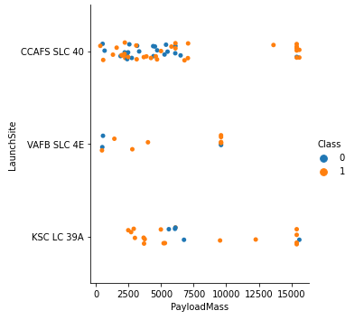
Payload vs. Launch Site
We can see that for Payload mass above 10000 VAFB SLC 4E site there are no launches.

Slide 21
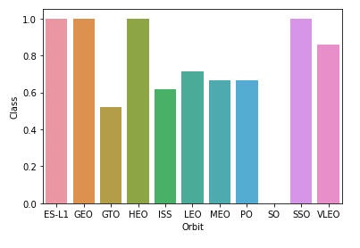
Success Rate vs. Orbit Type
ES-L1, GEO, HEO, SSO have higher success rate

Slide 22
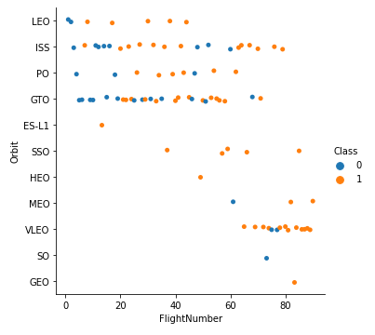
Flight Number vs. Orbit Type
For the LEO orbit, we can see there is a clear relationship between the Flight Number and the Success Landing

Slide 23
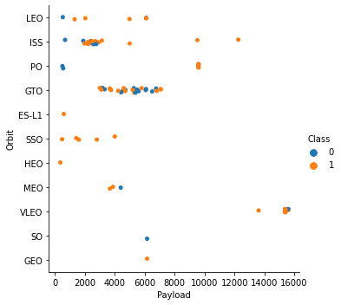
Payload vs. Orbit Type
For higher Payload, PO, LEO, ISS have higher success

Slide 24
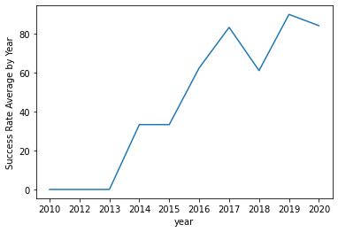
Launch Success Yearly Trend
The success rate increase over the time. Maybe experience and learning from errors had some part in the overall success

Slide 25
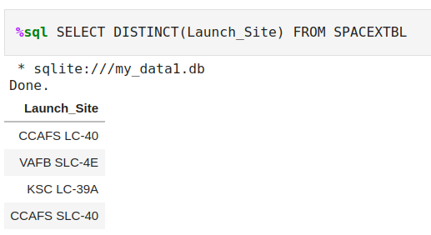
All Launch Site Names

Slide 26
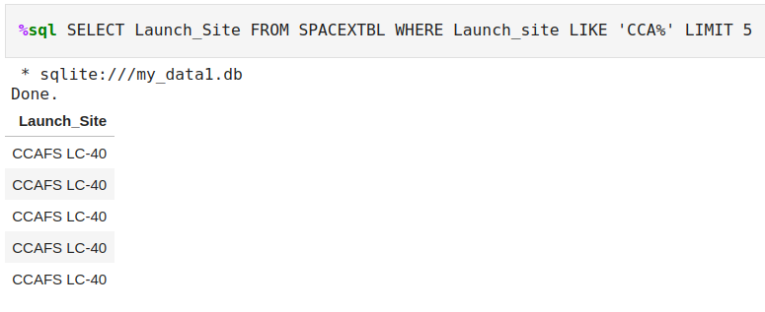
Launch Site Names Begin with 'CCA'

Slide 27
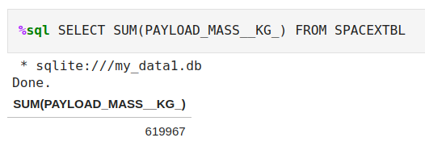
Total Payload Mass

Slide 28
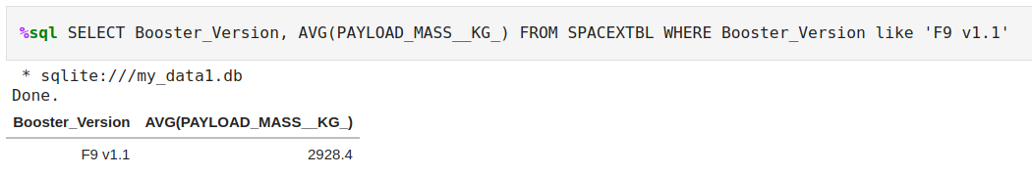
Average Payload Mass by F9 v1.1

Slide 29
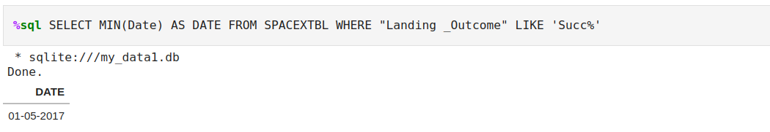
First Successful Ground Landing Date

Slide 30
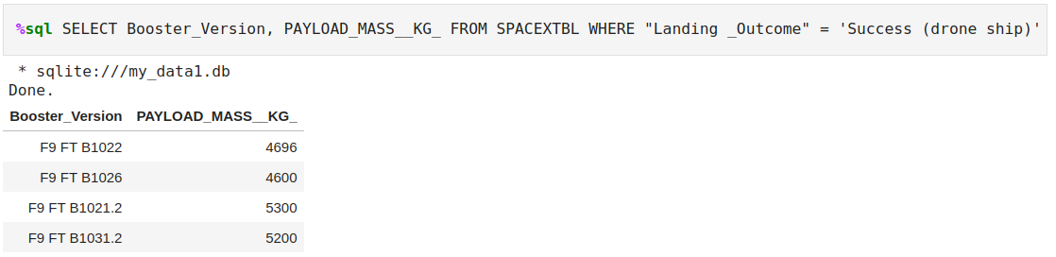
Successful Drone Ship Landing with Payload between 4000 and 6000

Slide 31
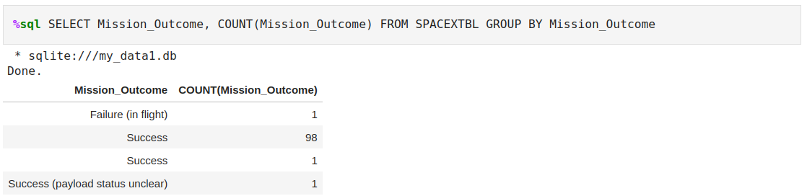
Total Number of Successful and Failure Mission Outcomes

Slide 32
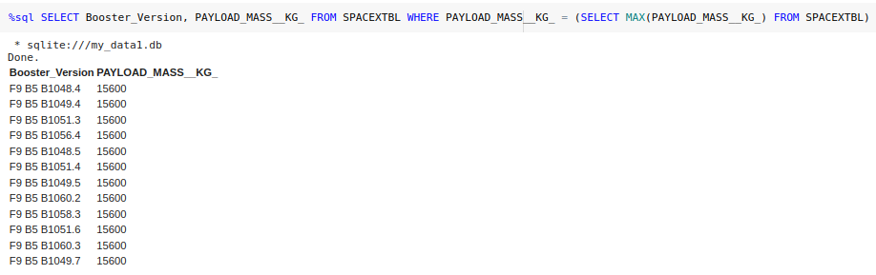
Boosters Carried Maximum Payload

Slide 33
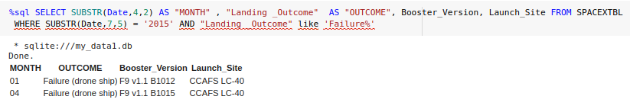
2015 Launch Records

Slide 34
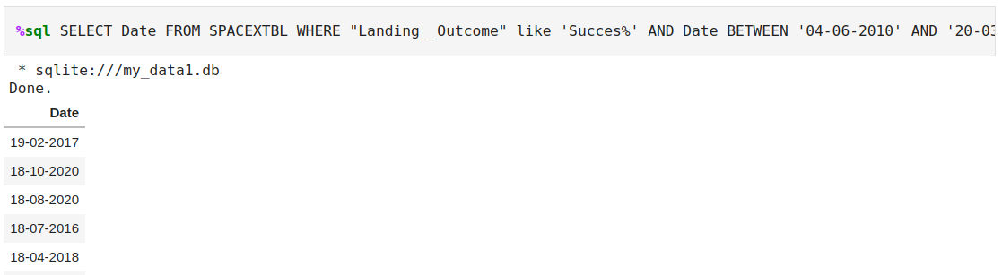
Rank Landing Outcomes Between 2010-06-04 and 2017-03-20

Slide 35

Section 3

Slide 36

All Launch Sites
All Launch Sites are in the U.S.A and near the coast

Slide 37

Launch Site with markers
Each marker cluster enables to show on the map the number of launches and their outcome.

Slide 38

Launch Site proximities
Every launch site is near the coast and far from city centers and far from railways and highways

Slide 39

Section 4

Slide 40
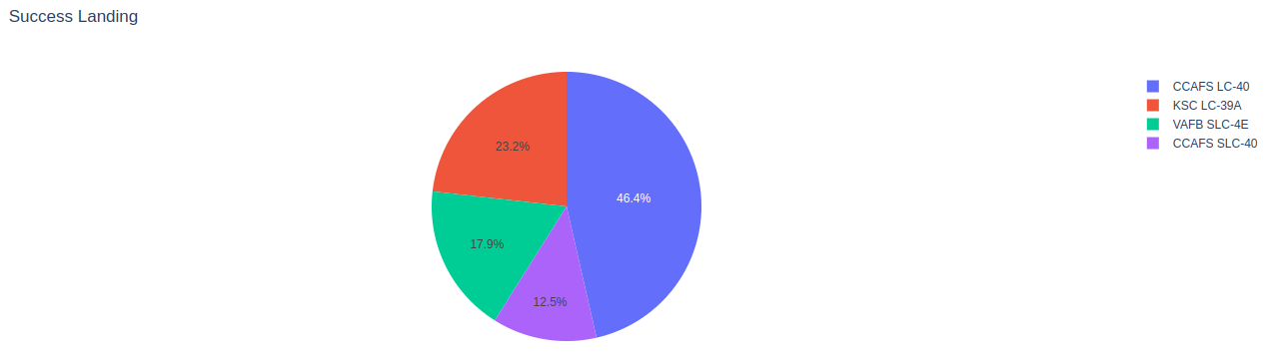
Pie Chart – Success Count per Launch site

Slide 41
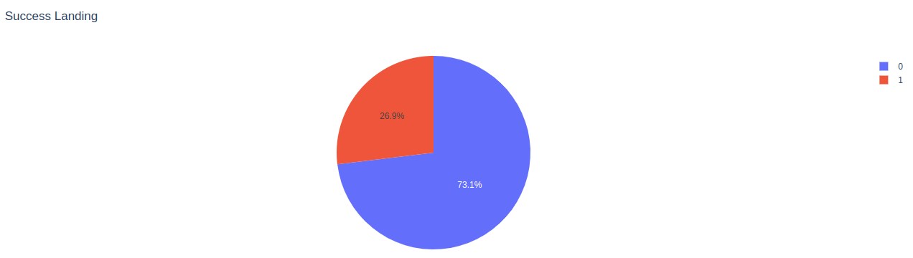
CCAFS LC-40 Success Ratio (Pie Chart)

Slide 42
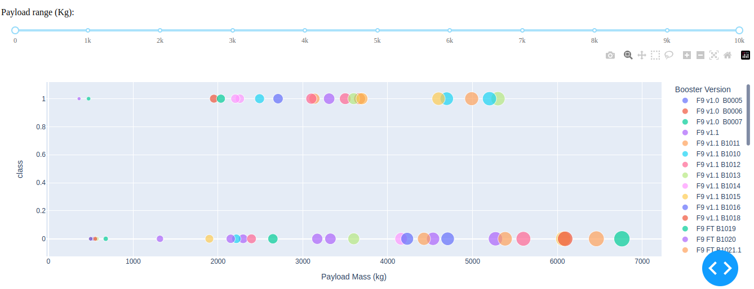
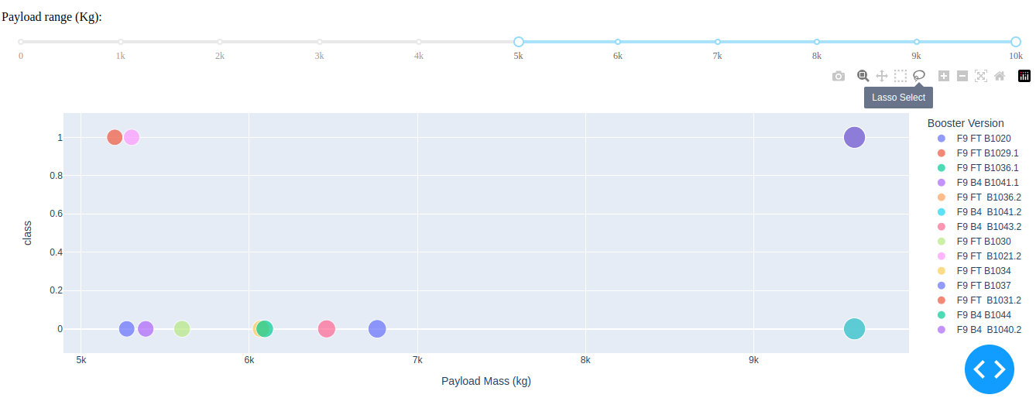
Scatter Plot by Payload range
Scatter plot for all sites for all Payload Range
Scatter plot for all site for a Payload Range of 5000Kg to 1000Kg

Slide 43

Section 5

Slide 44
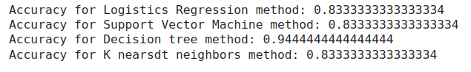
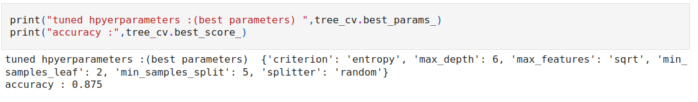
Classification Accuracy
The model with the best accuracy was the Decision Tree
With following parameters obtained through GridSearchCV

Slide 45
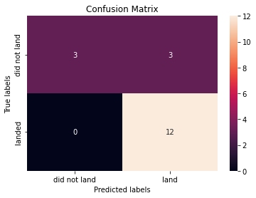
Confusion Matrix
We can see that the model correctly classified 12 landing, however it classified 3 as landed but in fact didn’t land and 3 correctly classified as didn’t land

Slide 46
Conclusions
We can conclude that the rate of success increased from 2013 until today.
The orbits ES-L1, GEO, HEO, SSO have higher success rate
The CCAFS LC-40 has the highest Landing Success Ratio
The Decision Tree is the algorithm with the best performance

Slide 47


